Slide 1
NEOMACE TRAVEL AND TOURS
Information Systems Plan
Belchez, Maica L. Carpio, Aira Joyce A. Haboc, Florence Gail G.

Slide 2
Company Overview

Slide 3
Brief History
Started…
Two branches: Makati and Bicol

Slide 4
Mission
List CEO and key management by name.
Include previous accomplishments to show that these are people with a record of success.
Summarize number of years of experience in this field.

Slide 5
Vision
List CEO and key management by name.
Include previous accomplishments to show that these are people with a record of success.
Summarize number of years of experience in this field.

Slide 6
Core Values
Summarize your market in the past, present, and future.
Review those changes in market share, leadership, players, market shifts, costs, pricing, or competition that provide the opportunity for your company’s success.

Slide 7
Goals
To provide best possible services to suite corporate, leisure as well as individual traveler.

Slide 8
Situational Review

Slide 9
Strengths
Weaknesses
Marketing skills
Plenty clients
Regular-basis clients
Service-oriented
Delay of submission of documents by applicants for passports
Requirements and instructions due to the delay in submission of clients’ other supporting documents
Delay in processing the documents
Limited employees
Reminders to clients

Slide 10
Opportunities
Threats
The use of technology for better client experience
Market branches
Growth of tourism worldwide
Online market strategy
Existing competition with other service providers
Economic uncertainties
Natural disaster and calamities or fortuitous events
Changes in technology
Consumers can change their tastes very quickly

Slide 11
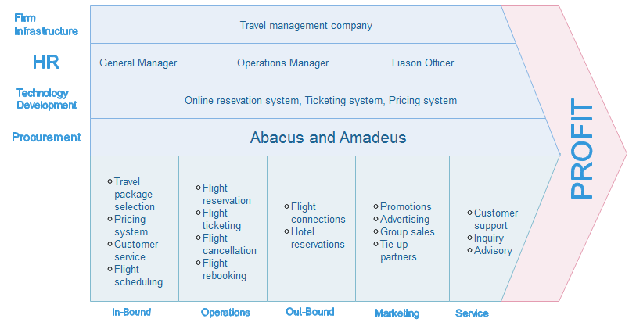
Value Chain Analysis

Slide 12
Gap Analysis
Objectives | Current State | Future State
More customers | Have regular customers and built trust | More advertisements and promotions
Enhance web services | Not enough details in website and bad user interface | Enhance website design and content. Make online transaction visible in the website
Employee expansion | Limited number of employees. No proper designation of tasks | Hire more employees by adding recruitment advertisement in the website

Slide 13
Industry Trends
Business Trend
Economy Sharing
Investment in Technology
Travel Spend Reduction

Slide 14
Business Context

Slide 15
Key Business Drivers
Increase of customers
Using of technologies for services
Employee engagement

Slide 16
Strategic Priorities
Outline a high-level financial plan that defines your financial model and pricing assumptions.
This plan should include expected annual sales and profits for the next three years.
Use several slides to cover this material appropriately.

Slide 17
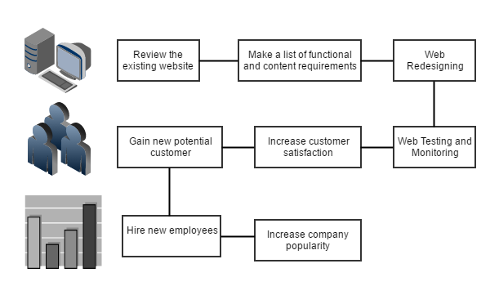
Strategic Roadmap

Slide 18
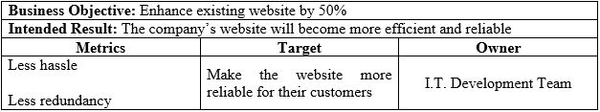
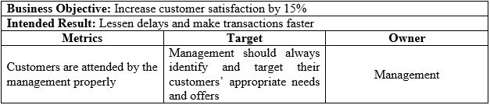

Strategic Business Objectives

Slide 19
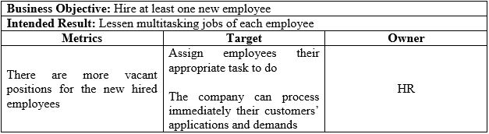
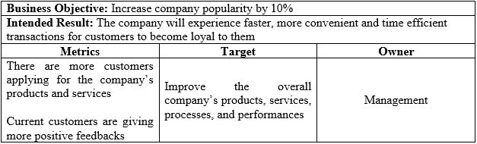

Slide 20
Strategic Initiatives

Slide 21
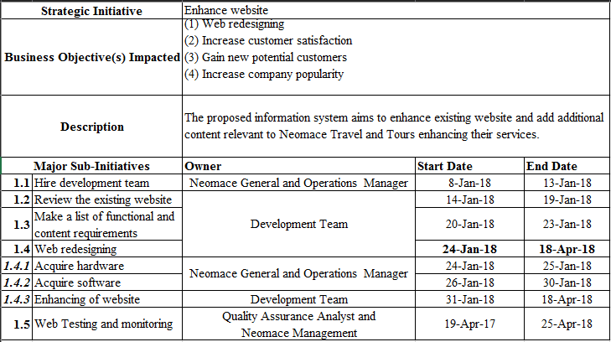

Slide 22
Financial Summary

Slide 23
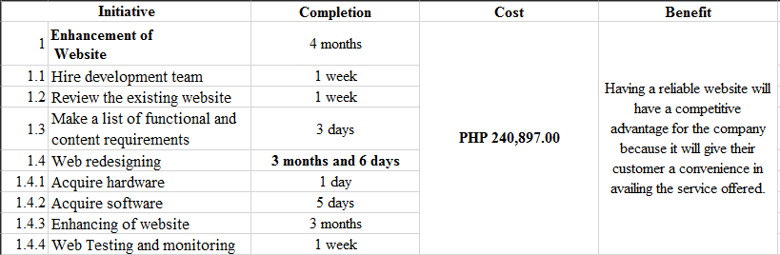

Slide 24
Process Flow Diagram

Slide 25
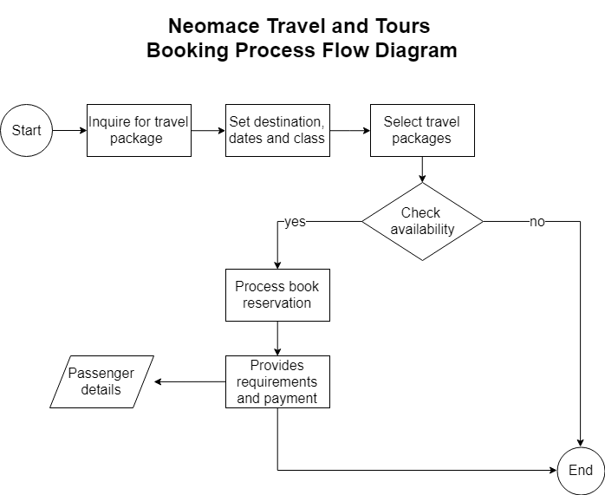

Slide 26
Project Estimate Cost

Slide 27
